Slide 1
MOVIE DATA
Exploratory SQL Analysis of IMDb Movies (2010–2019)
Part 2: Open-Ended Exploratory Analysis | SQL Summative Assessment

Slide 2
Initial data exploration summary
Things identified during data exploration
1
One invalid year,2115 and 9 years out of our 2010-2019 range
2
There are 1455081 total movies with 73856 total movies with ratings
3
3
The genre production increased steadily across all genres then dropped by the start of year 2019
4
Documentary has the highest number of movies produced of 13962 but lower number of votes 213.04 but higher rating of 7.32 compared to action with 6988 production,14476.49 human votes and a rating of 5.89
5
There is no linear relationship between runtime and ratings with a correlation of -0.00069

Slide 3
Business Question for Further Analysis
Given a fixed production budget, should a streaming platform prioritize genres with high audience engagement (like Action) or genres with high critical acclaim but low reach (like Documentary)
Data Cleaning Tasks Identified
1
Filter invalid start_year values outside 2010-2019 (e.g., an erroneous 2115 entry)
2
Exclude runtime outliers
3
Exclude nulls, don't impute: 31,739 missing runtimes, 5,408 missing genres
4
Normalize the comma-separated genres field into a movie-genre bridge table (~40% of titles list multiple genres)
5
Flag the ~49% ratings coverage gap explicitly in any rating-based conclusion
6
Standardize on one canonical title per movie (movie_akas has multiple regional titles per film)

Slide 4
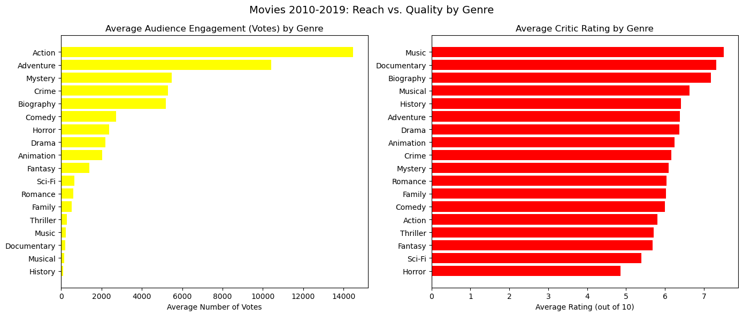
Reach vs. Quality: A Genre Trade-off

